Slide 1
California Classified School Employee Teacher Training Program
Program Application is Due December 15, 2017.
Beginning Teacher Programs
Mary Dolan – Project Director
Tom Leveron – Coordinator

Slide 2
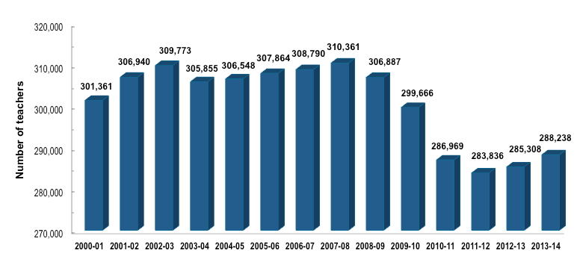
Number of K-12 Teachers in the State Teacher Workforce
Transitioning from Classified to Teacher Status. Why Now?
Source: California Department of Education; SRI International

Slide 3
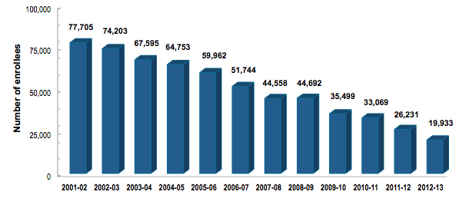
Enrollment in California Teacher Preparation Programs
Source: California Commission on Teacher Credentialing; SRI International

Slide 4
California’s Response to Teacher Shortage
Funding for the Classified School Employee Teacher Credentialing Program
Funding for universities to develop blended BA/Teacher credentialing programs

Slide 5
Basic Eligibility
Do you currently hold a full-time classified assignment?
Day-to-day substitute teachers are not eligible.
Adult education and CTE teachers are not eligible.

Slide 6
Determining Your Personal Eligibility And Readiness
Have you considered the financial implications, short-term and long-term of transitioning to a teaching position?
Have you considered that there will be demands on your personal time?
Have you considered the fact that you will lose job security as a classified employee?
Have you considered the fact that you may have to change employers?

Slide 7
Financial Implications
Basic teacher salary starts at around $50,000 and peaks at approximately $100,000.
Can you tolerate a short-term pay cut as a new teacher?
If your current salary is less than $50,000 clearly you will have a positive financial move from the start.

Slide 8
Demands On Personal Time
Training to become a teacher will demand time
Test preparation (CBEST and CSET)
Attendance at classes
Completing assignments
Reading
Commuting to and from class
Childcare
Less family time

Slide 9
Job Security
Currently your security is determined by seniority
Switching to teacher status will involve establishing a new level of seniority
May have to switch from your current employer
Are you confident and prepared to take this risk

Slide 10
Selecting Those That Are Truly Committed
Ask yourself this question, do I really want to be a teacher?
Why do I want to be a teacher?
Has this been something you have previously considered and wanted to do for long time?
Are you currently working in a teaching environment?
What do you want to teach?

Slide 11
LACOE’s Classified Employee Teacher Training Program
Awarded a total of 22 slots
Demand clearly outstrips supply
Focus will be on selecting those who can most quickly move to teacher status

Slide 12
Goal of LACOE’s
To transition 22 individuals as expeditiously as possible to California teacher status

Slide 13
Next Steps: Application Requirements
Academic Eligibility
Current Classified Employment status
Official Transcripts
Completion of online application by December 15, 2017 before 5pm
http://www.btplacoe.com/

Slide 14
Candidate Selection Process
Selection team identifies strongest applicants
Verification of classified employment
Request for official transcripts
Follow-up interview with applicant
Notification to successful applicants
Applicant acceptance
*** Do not provide transcripts unless requested to do so.

Slide 15
Understanding The Structure Of The Program
There will be an individual advisement with each successful candidate
An individual plan will be developed (start CSET or CBEST prep, enroll in pre-service, etc.)
Candidate will implement individual plan and funding will be provided to support progress (e.g. reimbursement of test registration fees, textbooks, class registration fees)
Maximum of $3,000 per year available

Slide 16
Institution Of Choice
You may select where to attend and complete courses/program
You will have to pay out of pocket for the difference
LACOE
Least expensive
Grant will go further with LACOE
Less, if any out of pocket cost

Slide 17
If You Are Not selected…
Other programs that are available (tuition based)
Los Angeles County Office of Education District Intern Program is accepting applications
http://www.btplacoe.com/
http://www.btplacoe.com/district-intern-program.html

Slide 18
In Conclusion…
22 slots are available
Applications due December 15, 2017 before 5pm
Successful applicants will be notified December 22, 2017
If you are eager, determined and committed to making the transition to becoming a fully credential teacher, please apply.

Slide 19
Thank you!

